Slide 1
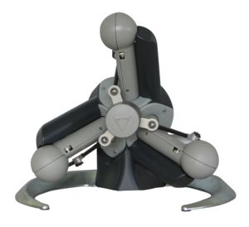
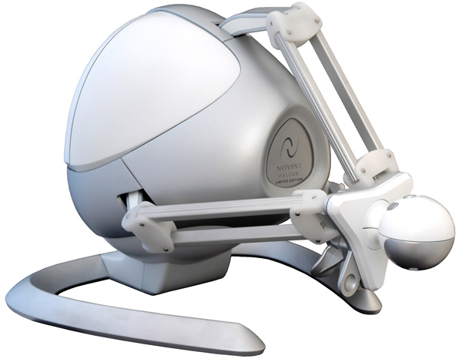
3-DOF vs. 6-DOF
Playful Evaluation of Complex
Haptic Interactions
René Weller and Gabriel Zachmann
Clausthal University, Germany
{weller,zach}@in.tu-clausthal.de
ICCE ’11, Jan 2011, Las Vegas, NV

Slide 2
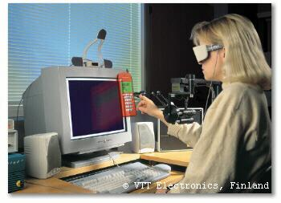
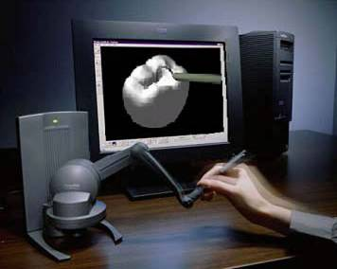
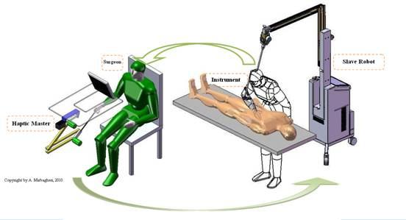
Haptics in Industrial Applications
Harvard School of Dental Medicine
VTT Electronics
Virtual Prototyping
Training
Tehran University
Teleoperation
Motivation Haptic Workspace User Study Results Conclusion

Slide 3
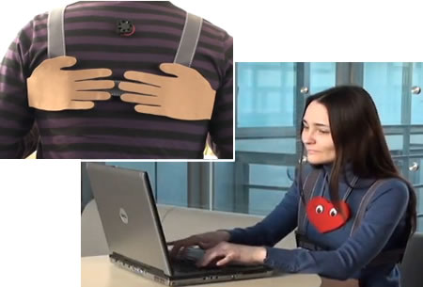
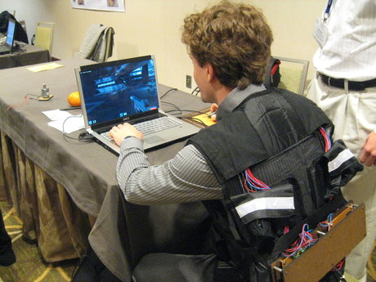
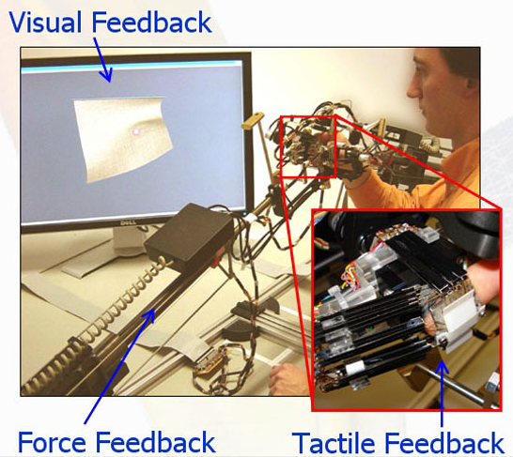
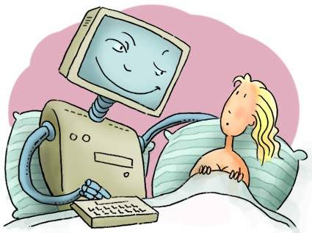
Haptics in CE
University of Pennsylvania
Games
Tachi Lab
Real-Time Messaging
MIRALab
Online Shopping
Adult Entertainment
Motivation Haptic Workspace User Study Results Conclusion

Slide 4
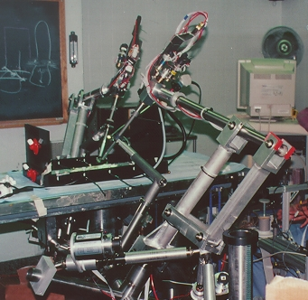
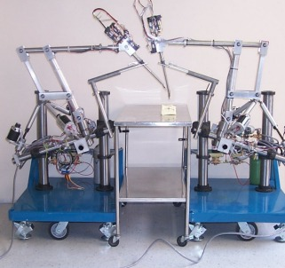
Motivation
UC Berkeley
Cost a limiting factor
Cost depends on number of actutors
  => Low cost devices: 3-DOF
Natural interaction requires also torques
Is the enhanced 6-DOF experience worth the additional cost?
Motivation Haptic Workspace User Study Results Conclusion

Slide 5
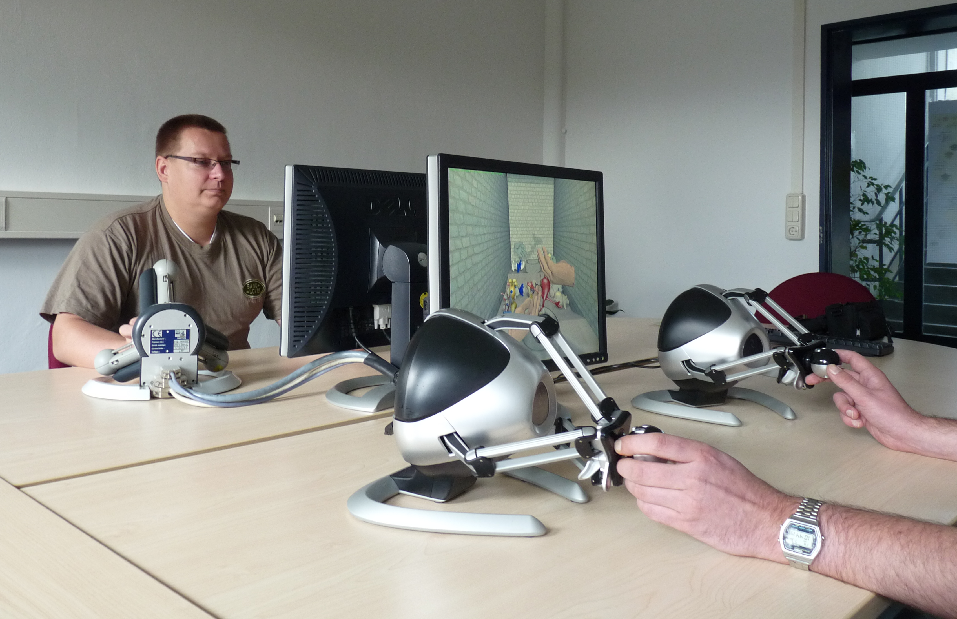
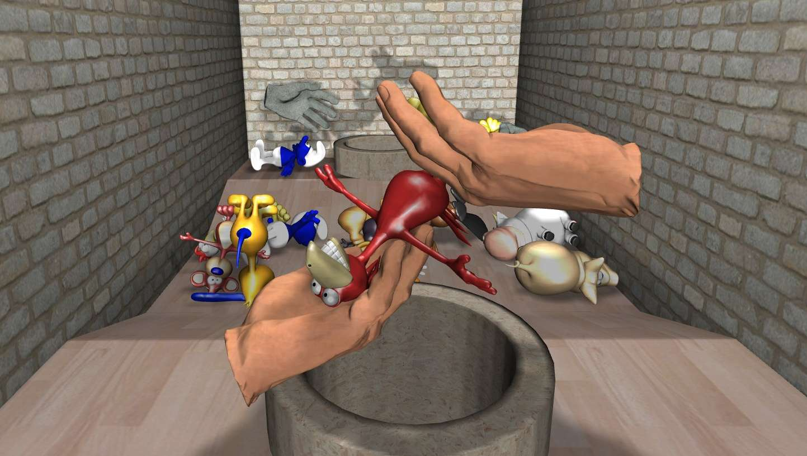
Our Contribution
Haptic Workspace
  High-fidelity 6-DOF rendering
  Large number of objects
Bi-manual multi-user game
  Quantitative and qualitative analysis
User Study
Motivation Haptic Workspace User Study Results Conclusion

Slide 6
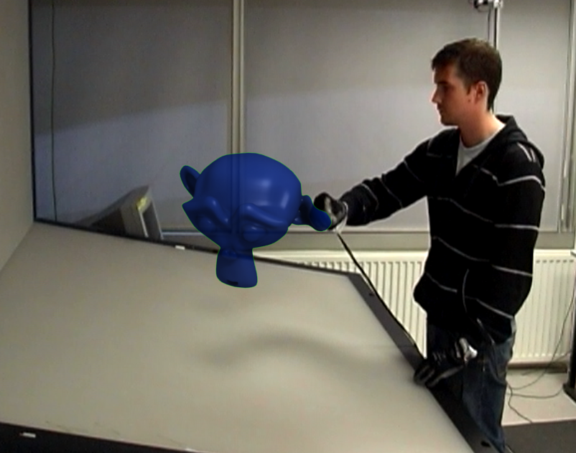
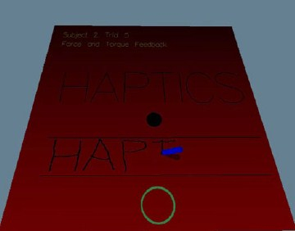
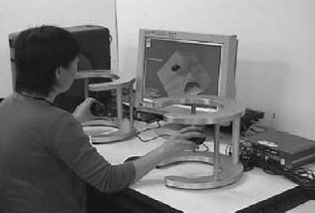
Previous Works
Integrality and separability of input devices
  Jacob et. al., 1994
Influence of degrees of freedom’s manipulation on performances during orientation tasks in virtual reality environments
  Veit and Bechmann, 2009
Force & torque feedback vs force only feedback
  Verner and Okamura, 2009
Spidar G&G: A two-handed haptic interface for
bimanual VR interaction
  Murayama et. al., 2004
Motivation Haptic Workspace User Study Results Conclusion

Slide 7
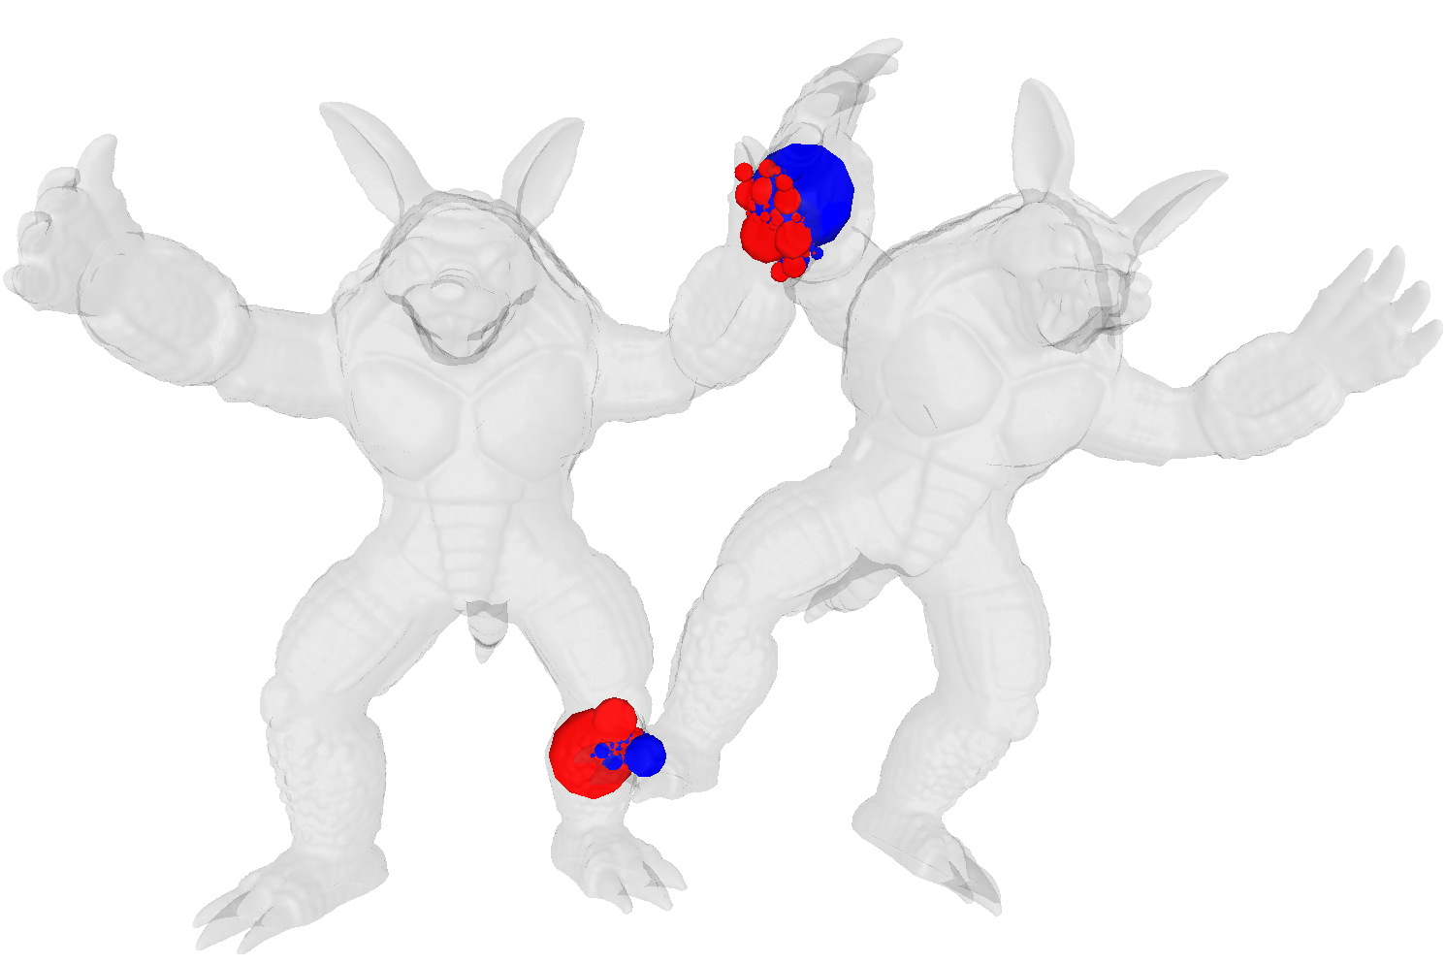

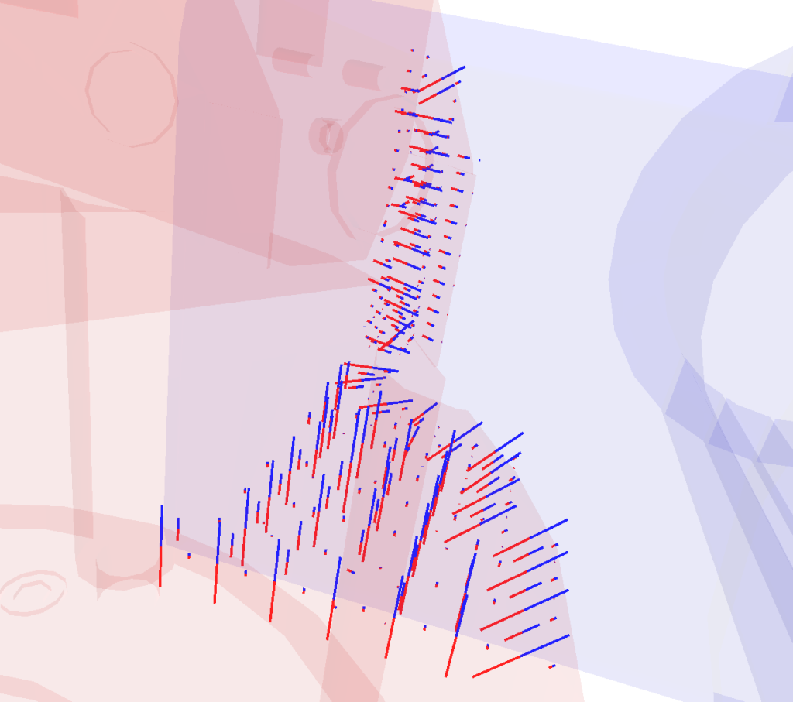
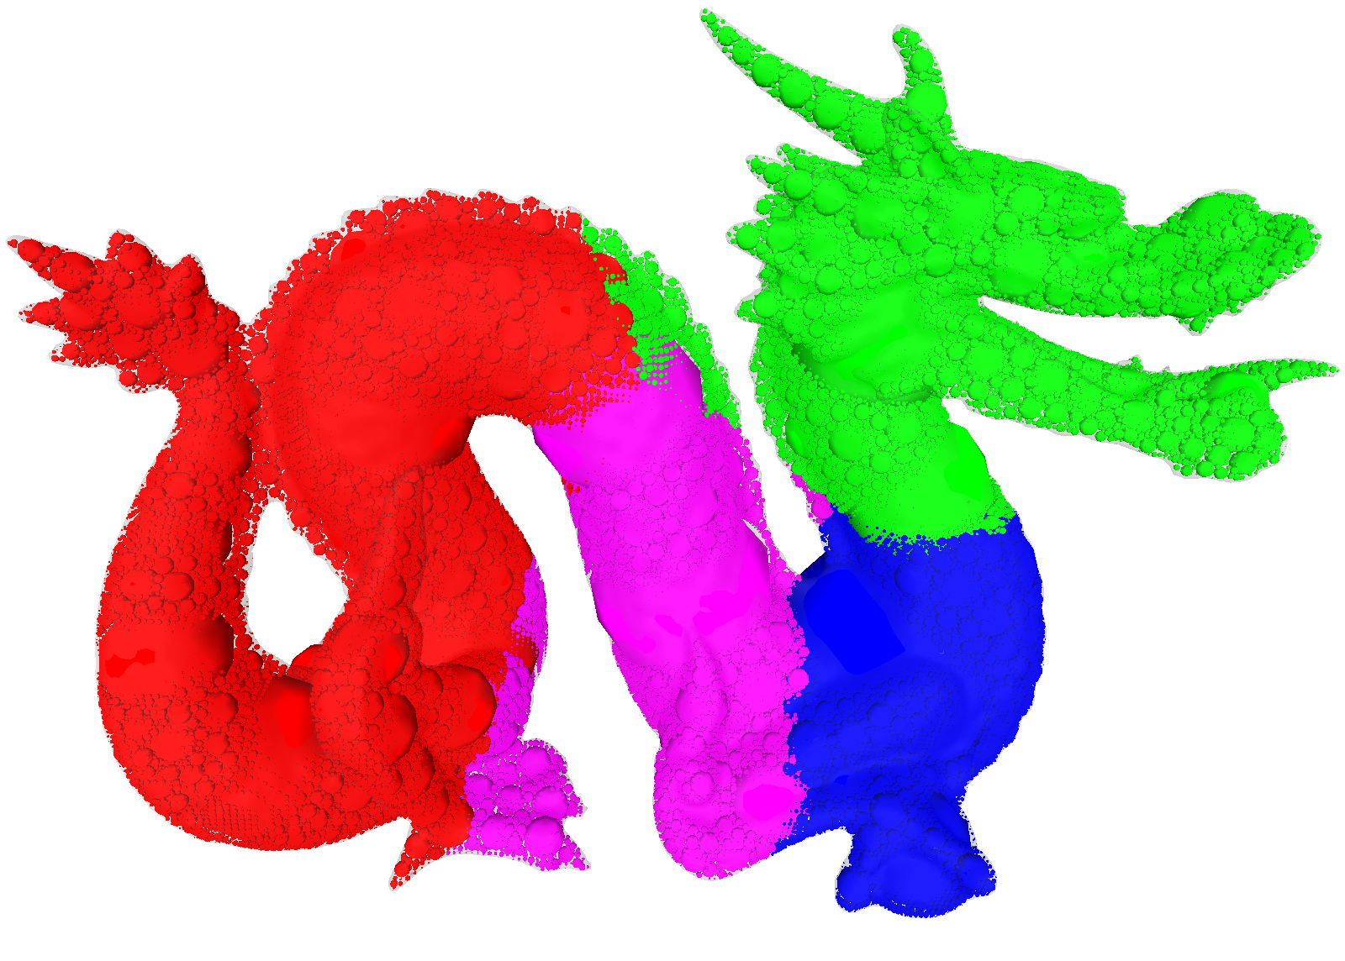
Our Haptic Workspace
1000 Hz simulation rate
Bottleneck: Collision detection
Motivation Haptic Workspace User Study Results Conclusion

Slide 8
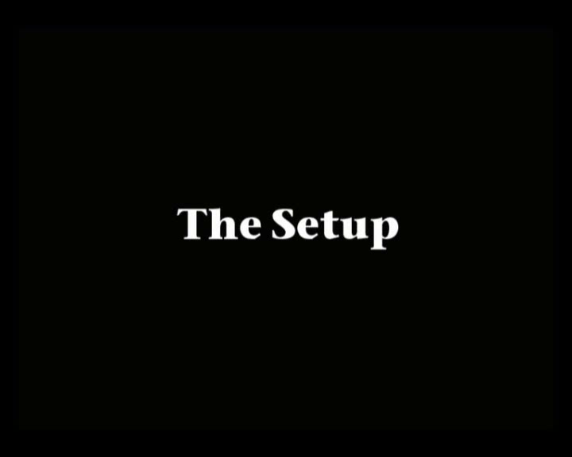
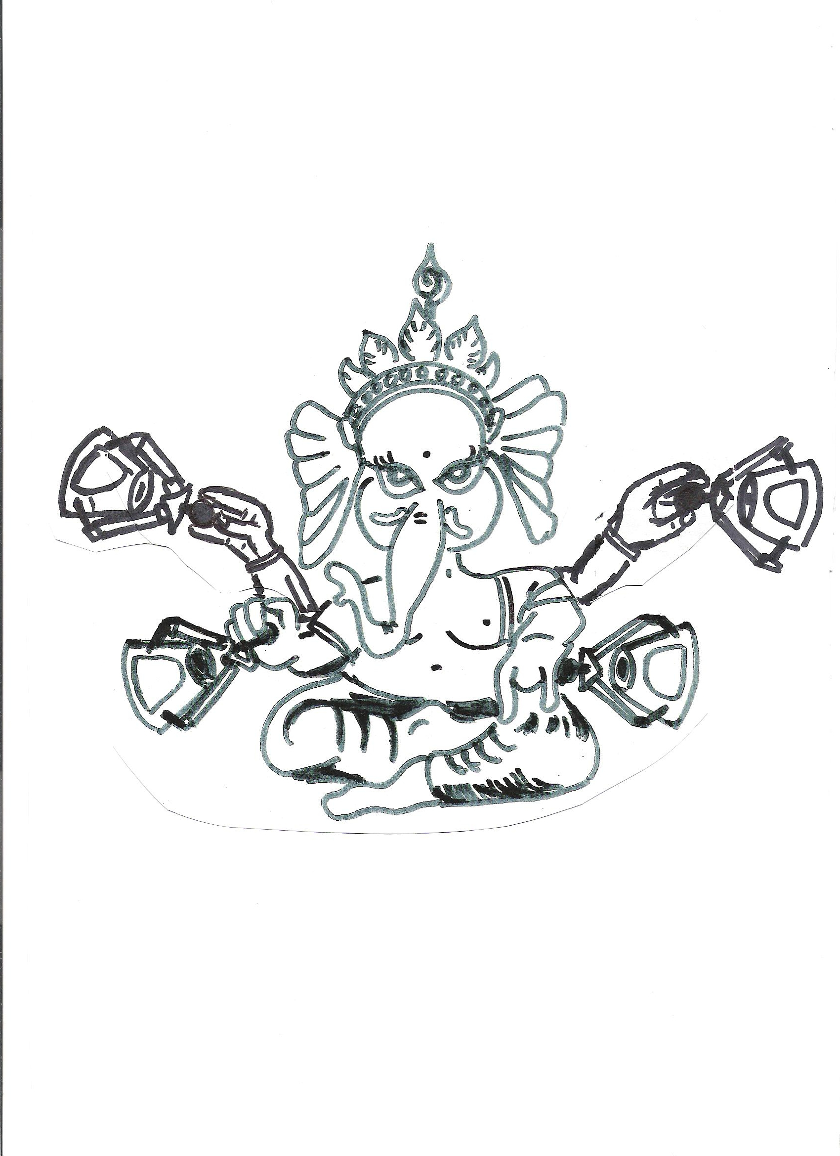
Our Haptic Game
Haptesha
Motivation Haptic Workspace User Study Results Conclusion

Slide 9
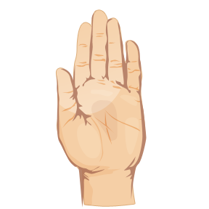

User Study
Protocol
  Max 3 minutes training
  3 minutes game
  Questionnaire
47 participants
  Age: 17-34 years
  33 14
  44 3
Experience
  27 regularly
  5 regularly
  8 used haptic device before
3-DOF | 6-DOF
Novint Falcon | Haption 6D Desktop
Translation: 102mm cube | 120mm diameter sphere
- | 35° rotation in all directions
Translational Force: 10N | 15N
- | 0.5 Nm torque
$200 | $30.000
Motivation Haptic Workspace User Study Results Conclusion

Slide 10
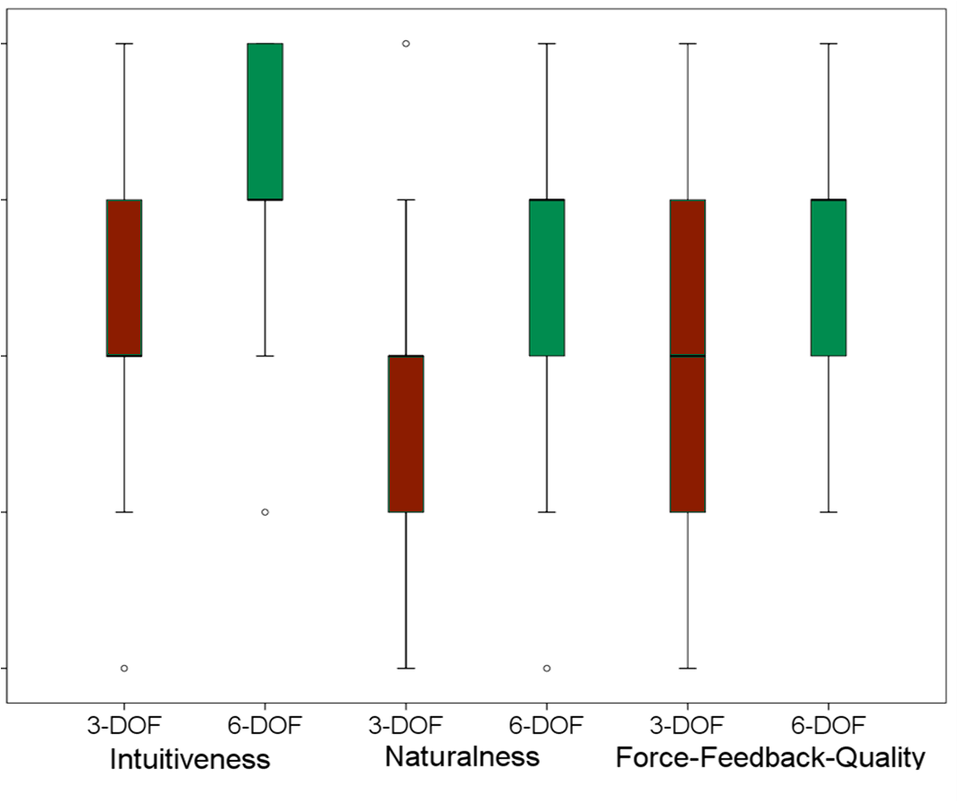
Results: User Perception
Perfect
Unsatis-fiable
Motivation Haptic Workspace User Study Results Conclusion

Slide 11
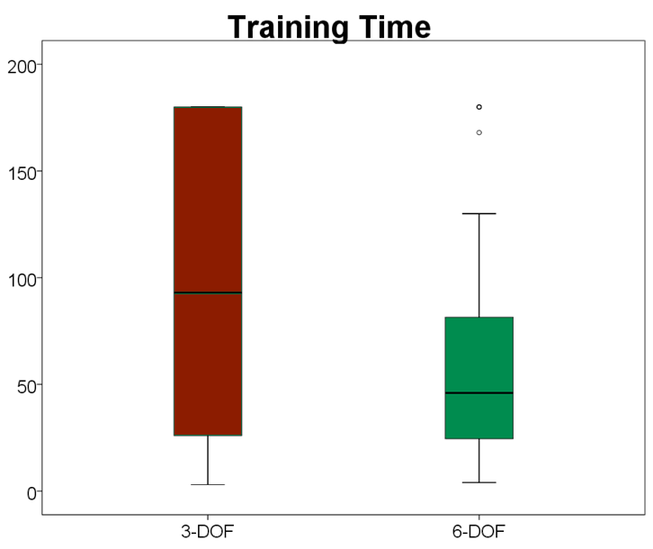
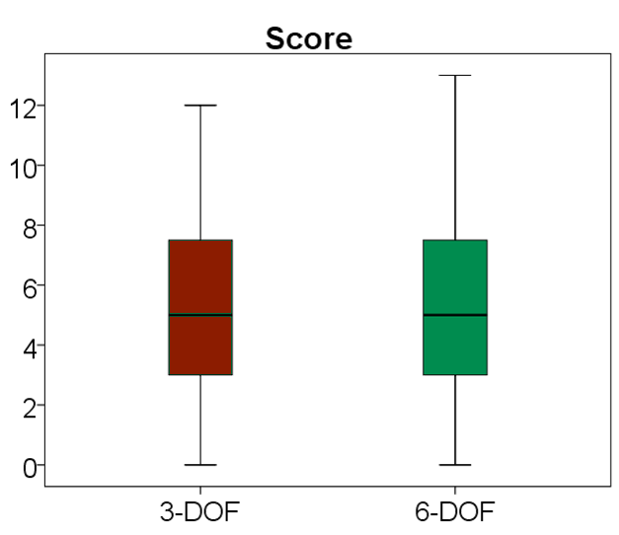
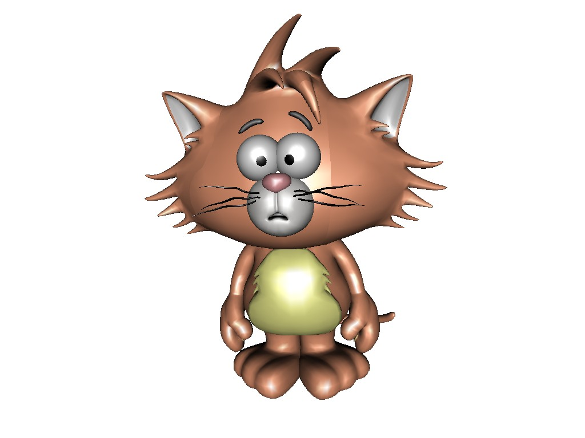
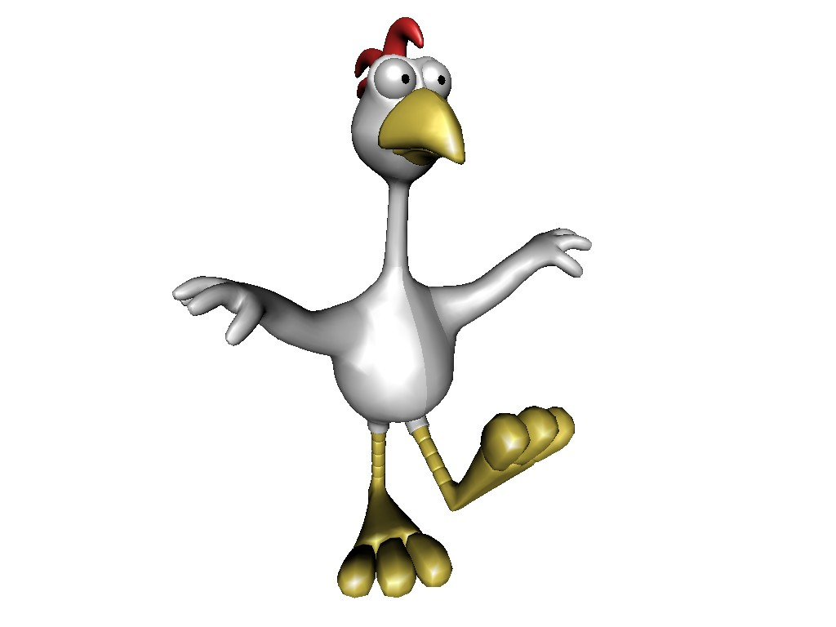
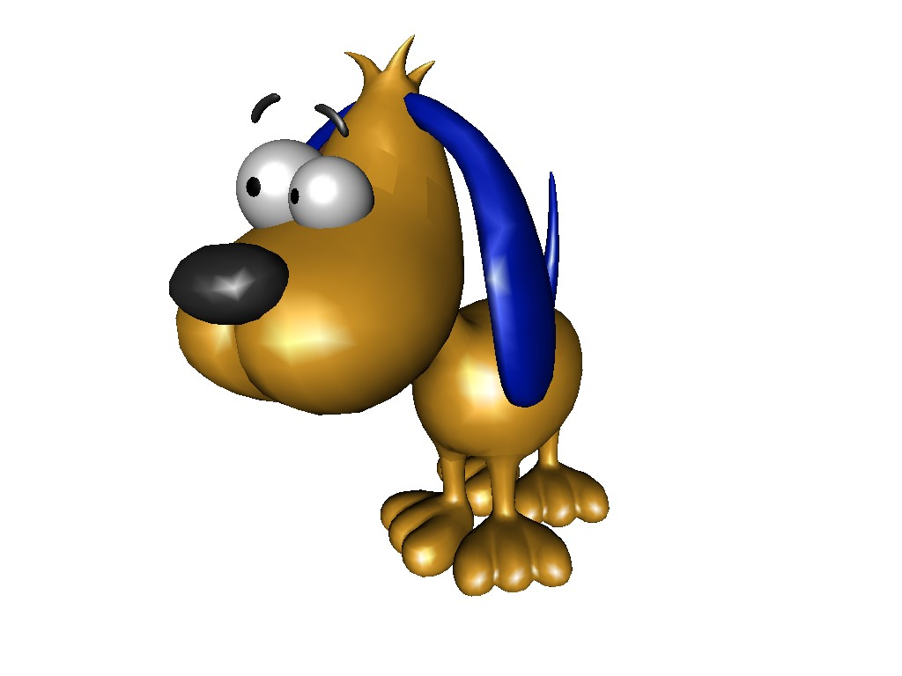

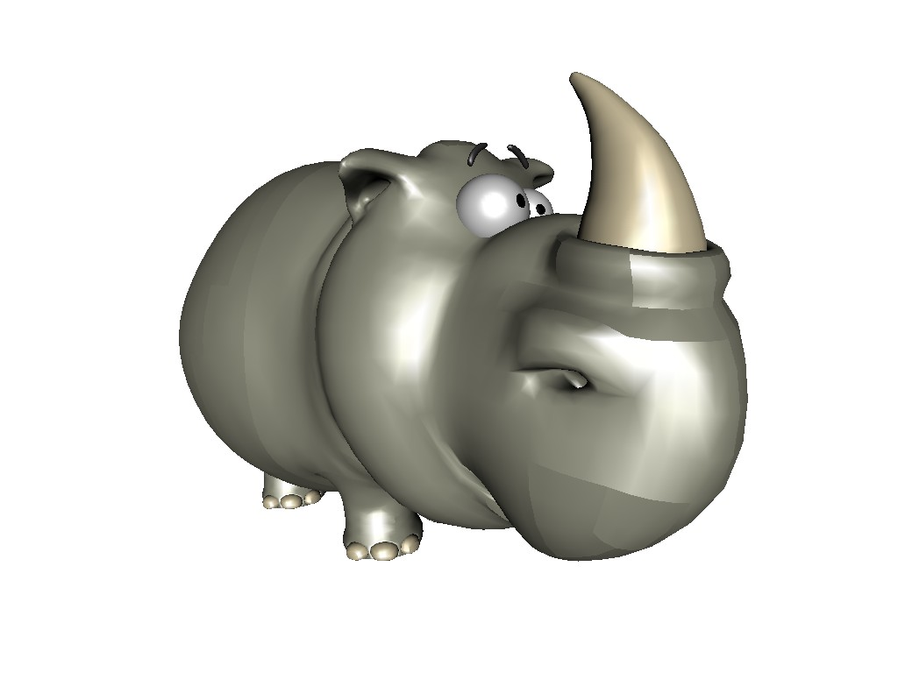
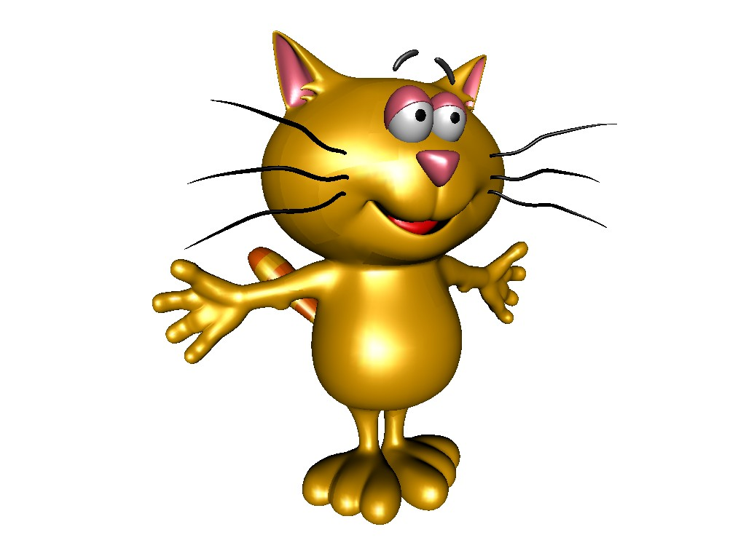
Results: User Performance
Motivation Haptic Workspace User Study Results Conclusion

Slide 12
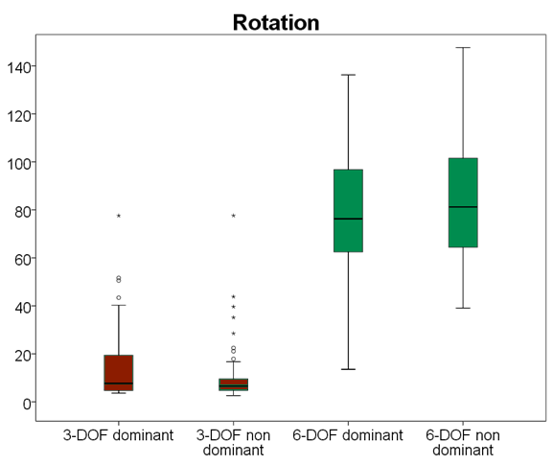
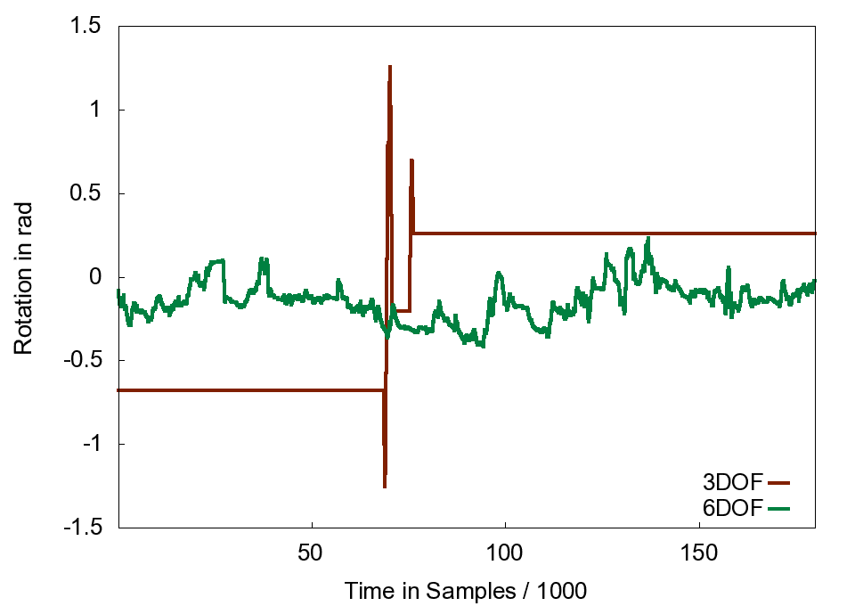
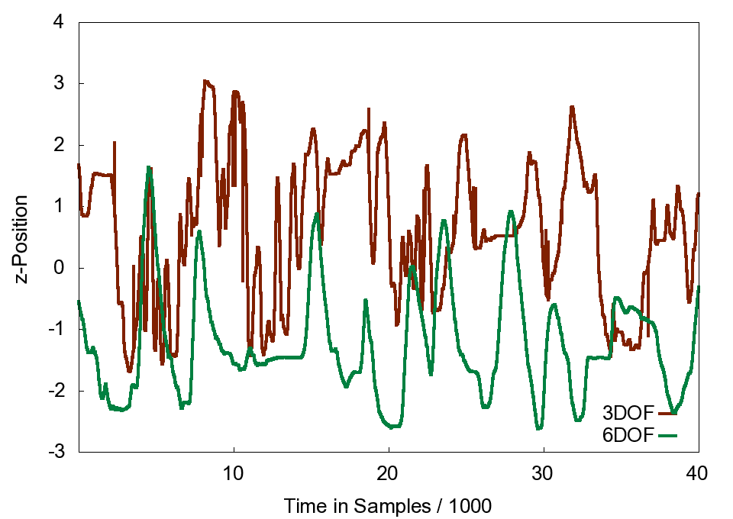
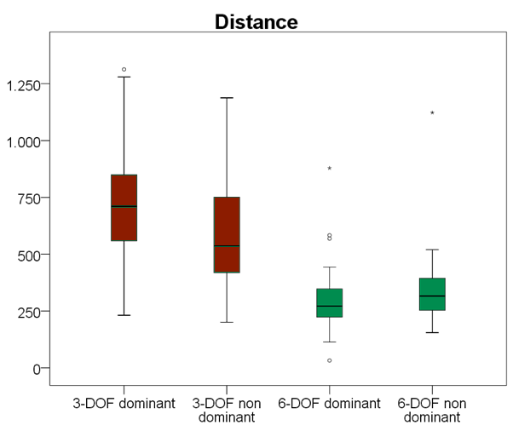
Results: Efficiency
Motivation Haptic Workspace User Study Results Conclusion

Slide 13
Conclusions and Future Works
New bi-manual multi-user haptic workspace
  Based on IST collision detection
  Physically based simulation and haptic rendering
Multiplayer game
  Simulation of complex haptic interactions
Quantitative and qualitative analysis
User study
  6-DOF outperforms 3-DOF with respect to user perception and user performance
Find trade-off between cost and performance
  Asymmetric set-ups
Friction, deformable objects
Motivation Haptic Workspace User Study Results Conclusion

Slide 14

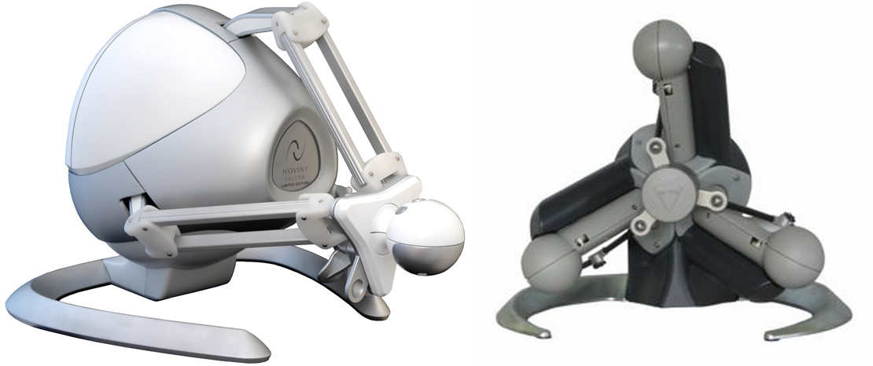
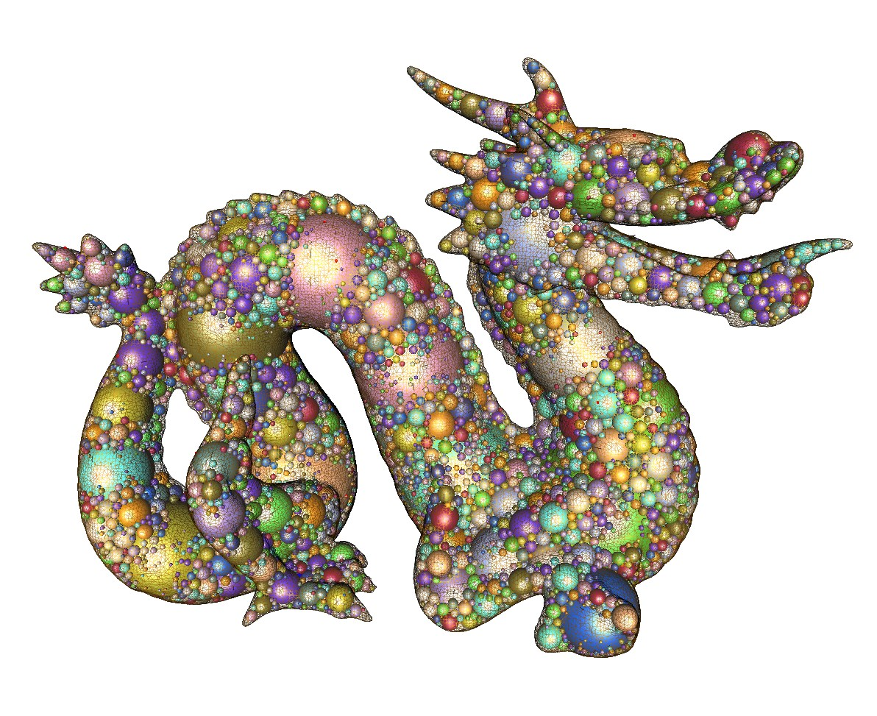
Acknowledgments
DFG grant ZA292/1-1
BMBF grant Avilus / 01 IM 08 001 U.
Jerome Perret of Haption

